Slide 1
CMGT400 Intro to Information Assurance and Security (University of Phoenix)
Lecture, Week 2
Tom Olzak, MBA, CISSP

Slide 2
Malware
Virus – First malware. Requires user action.
Worms – Most common in large-scale attacks. Moves on its own
Trojans – Often coupled with a rootkit. Users install them thinking they are valid programs. Collect user information
Rootkits – Difficult to detect and almost impossible to completely remove. Embed themselves deep in the operating system, often replacing one or more device drivers.

Slide 3
Network Segmentation
Divides internal network into smaller networks
Creates many smaller attack surfaces
Groups data and systems according to classification and risk
Allows security teams to apply scarce budget dollars where they are needed most
More information: http://http://resources.infosecinstitute.com/vlan-network-chapter-5/

Slide 4
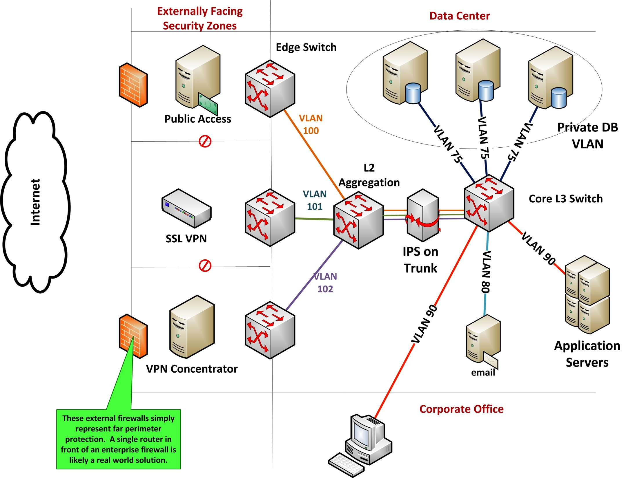

Slide 5
Vulnerability Detection
Scans – Regularly perform vulnerability scans. Tools include these top-rated solutions http://www.ehow.com/list_7510537_top-10-vulnerability-scanners.html
Vendors
Security organizations
US-CERT (http://www.kb.cert.org/vuls/)
SANS Institute Internet Storm Center (https://isc.sans.edu/)
Good for emerging threat information

Slide 6
Web Filtering
Block all websites except those needed for business
Whitelisting v. Blacklisting
Web filter solutions
OpenDNS
WebSense
For more information about OpenDNS and how Web filtering works, see http://mcaf.ee/7va6b

Slide 7
Email Filtering
Stop malware before it gets to the email servers
Use two filters from different vendors
Block all high-risk attachments
For one administrator’s list of denied extensions, see https://my.bluehost.com/cgi/help/364

Slide 8
SIEM
Security Information and Event Management
Required for comprehensive monitoring and detection
Individual device/system log reviews largely ineffective
Too much to view
No big picture perspective

Slide 9
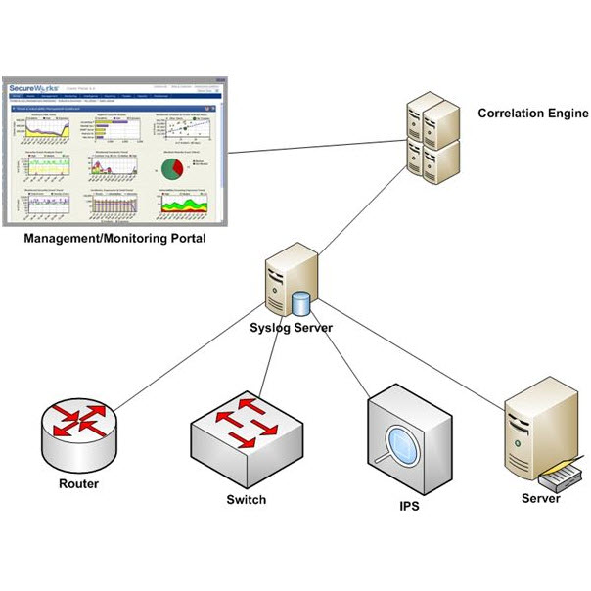
Controls

Slide 10
Cost/Benefit Analysis
Based on risk, especially business impact
Process based on business impact
Calculate the business impact
Calculate the cost of mitigating controls
If the cost of controls is lower than business impact, implement the controls
If the cost of controls is higher than business impact, spend your budget dollars elsewhere

Slide 11
Regulations (U.S.)
Sarbanes-Oxley Act (SOX) - http://www.sox-online.com/basics.html
Gramm-Leach-Bliley Act (GLBA) - http://business.ftc.gov/privacy-and-security/gramm-leach-bliley-act
FISMA - http://csrc.nist.gov/groups/SMA/fisma/index.html
HIPAA - http://www.hhs.gov/ocr/privacy/
Privacy
Security
PCI DSS (industry standard, but non-compliance comes with a high price…) https://www.pcisecuritystandards.org/security_standards/

Slide 12
And again…
Be sure to read ALL assigned reading. Your success in this class depends on it.

