Slide 1
CMGT400 Intro to Information Assurance and Security (University of Phoenix)
Lecture, Week 3
Tom Olzak, MBA, CISSP

Slide 2
Access Control
Mandatory Access Control (MAC) – Administrators tag data and users. An access control solution restricts access according to tags.
Discretionary Access Control (DAC) – Users set and manage security on the information they create, or administrators set access control user-by-user.
Role-based Access Control (RBAC) – The business creates roles based on business processes, separation of duties, least privilege, and need-to-know. Roles are assigned rights and permissions. Users are assigned to roles.

Slide 3
MAC

Slide 4
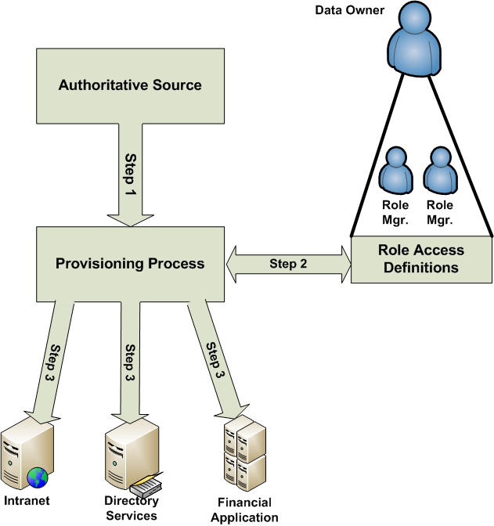
RBAC

Slide 5
Standards of Best Practice
COBIT (Control Objectives for Information and Related Technology)
https://www.isaca.org/Pages/default.aspx
ISO/IEC 27002:2005 (Information Technology – Code of Practice for Information Security Management
http://www.27000.org/iso-27002.htm
ITIL (Information Technology Infrastructure Library)
http://www.itil-officialsite.com/
NIST CSRC – (National Institute of Standards and Technology, Computer Security Resource Center)
http://csrc.nist.gov/publications/PubsSPs.html

Slide 6
Firewalls
Block everything, and then open only the port/IP address pairs absolutely required to conduct business
Maintain up-to-date firewall operating systems
Use internally and at the perimeter
Network and host

Slide 7
IPS/IDS
IPS (Intrusion Prevention System)
Detects anomalous packets and network behavior
Alerts or blocks traffic based on administrator defined rules
Placed in line with traffic
IDS (Intrusion Detection System)
Detects anomalous packets and network behavior
Alerts based on administrator defined rules
Placed out-of-band
Tuning Required

Slide 8
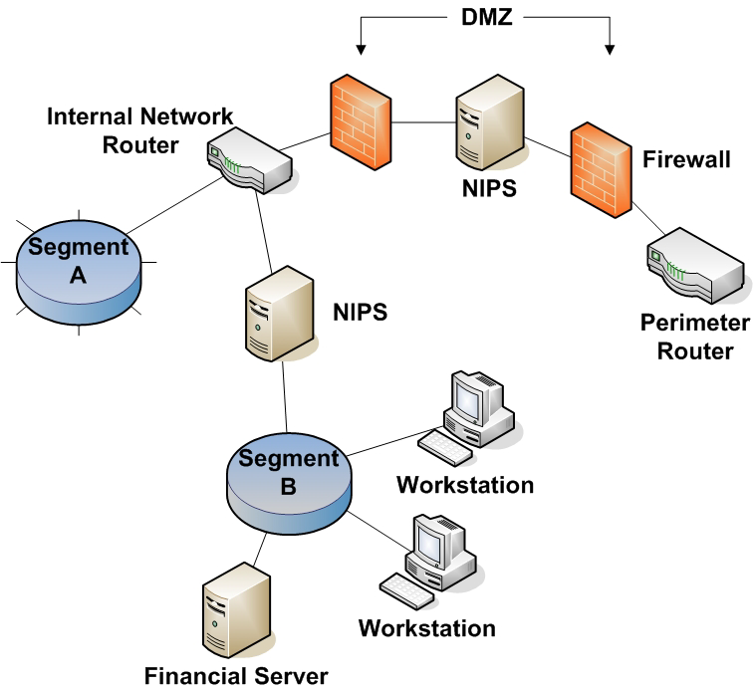
IPS/IDS Example

Slide 9
Business Continuity Planning
Purpose: Enable quick response to business continuity events so critical business process downtime does not exceed maximum tolerable downtime (MTD)
Business continuity event: Any condition, or set of conditions, that interrupts one or more business processes.
Disaster recovery: Restoring business processes following a catastrophic business continuity event.
Plan for worst case scenarios

Slide 10
Backups
Necessary for disaster recovery
Three types:
Full – Everything backed up
Incremental – Backs up everything that changed since the last backup of any kind
Differential – Backs up everything that changed since the last full backup
Off-site storage necessary
Media types
Tape
Disk
Cloud
Co-location

Slide 11
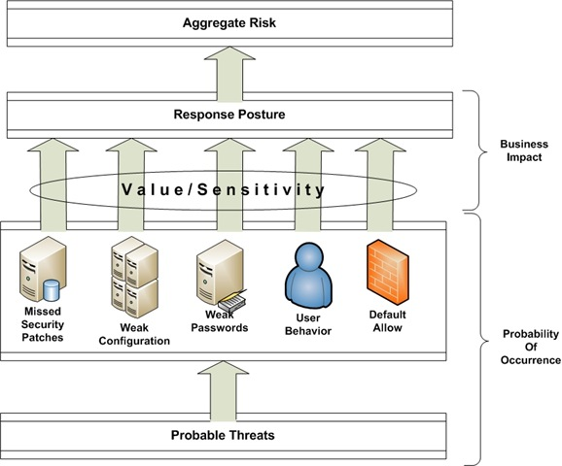
Aggregate Risk

Slide 12
And again…
Be sure to read ALL assigned reading. Your success in this class depends on it.

